Slide 1

CYCLISTIC BIKE SHARE
Presented by: Nguyen Duy
Updated : 7/26/2021

Slide 2
Contents
Introduction
Problems and questions
Analyzing
Findings
Conclusions and recommendations
Further analysis

Slide 3
1. Introduction
Cyclistic is a bike share company in Chicago with more than 5800 bicycles and 600 docking station
Company has 2 type of customer: casual customers* and annual customers**
The annual customers bring more benefit than casual customers
The director wants to optimize number of annual customer
She wants to know what are the key differences between two type of customers and how to convert casual customer to annual customers
Notes:
*Casual customers are who pay for bike trip by hour or day
** Annual customers are who buy membership and pay for annual

Slide 4
Problems and questions
Annual customers bring more benefit than casual customers
-> Convert casual customers to annual customers
Questions:
1. How do annual members and casual riders use Cyclistic bikes differently? 2. Why would casual riders buy Cyclistic annual memberships? 3. How can Cyclistic use digital media to influence casual riders to become members?

Slide 5
3. Analyzing
By using the 12 months historical data of trips (from July 2020 to May 2021)
Total >300 Mb csv files so:
Too large with Excel
Be restricted 100Mb with Big Query Cloud
d Using R is the best choice for cleaning and analyzing
Using Power BI for visualizing and conducting more analysis

Slide 6
3. Analyzing
Combine 12 files csv to a single large file
Data cleaning
Define trends on the started hour and ended hour of trips
Define trends on weekdays
Define trend on time per trips and routes of trips

Slide 7
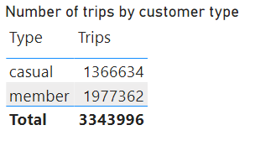

4. Findings
Casual customers ride durations are longer than annual customers
Rides duration normally between 11 and 21 minutes
Annual customer ride more times than casual customer
 | Casual | Annual
Average | 45 | 15
Median | 21 | 11
Max | 55683 | 58720
Min | 0 | 0
Casual customers pay for hour-by-hour bike ride, why annual customer gain more profit? And why they don’t use the membership?

Slide 8
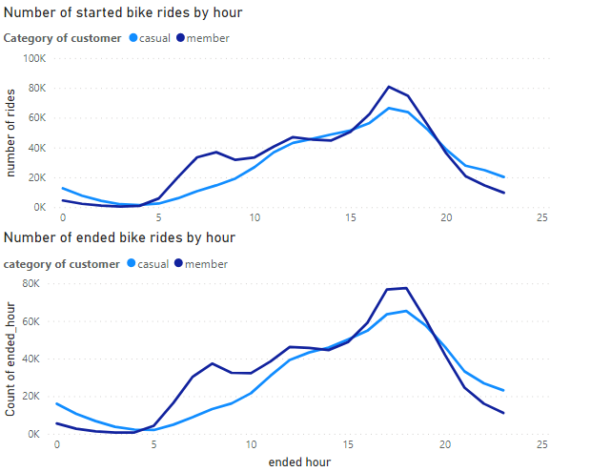
4. Findings
There are no significantly difference between two type of customer
Customers have high demand for bikes from 6am to 8pm
The mode hour of started trip is 5pm and 6pm with ended trip

Slide 9
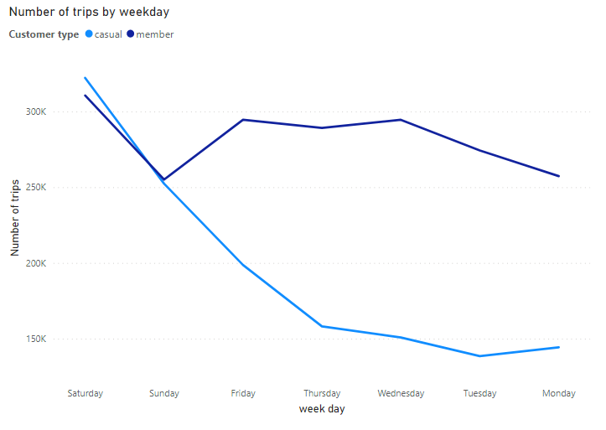
4. Findings
Annual customers have consistently demand for biking through weekdays
Casual customers have high demand in the weekend than working days
Annual customers are more likely bike for commuting and casual bike for entertaining?

Slide 10
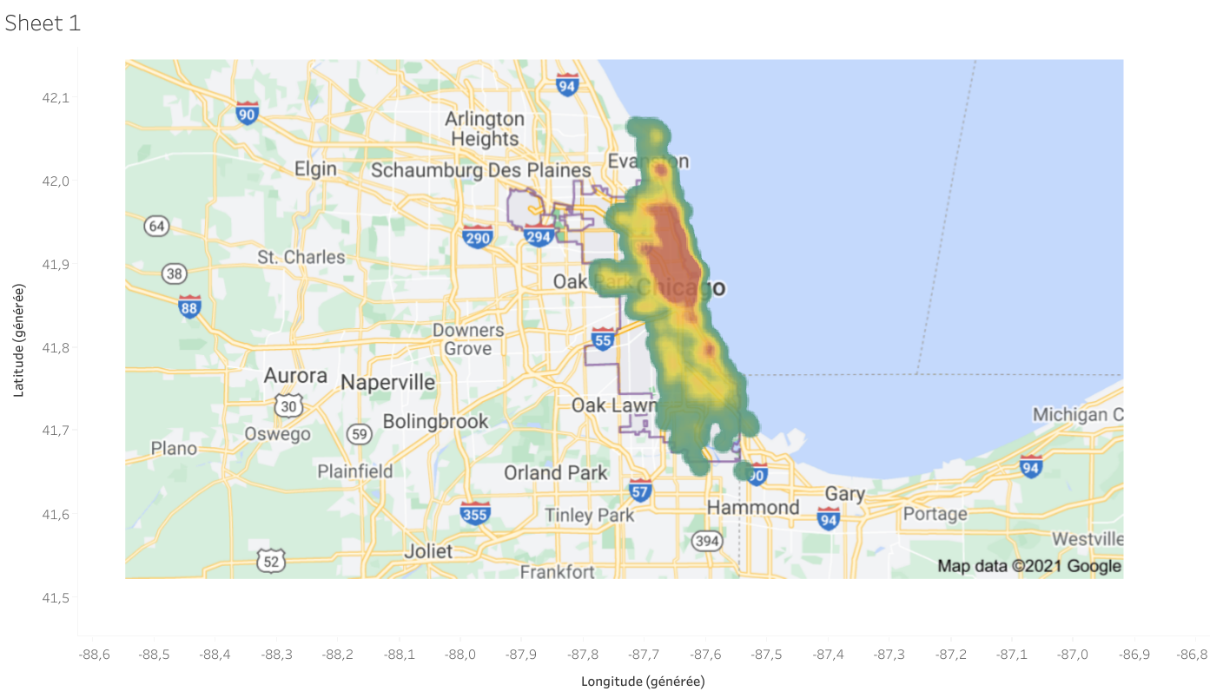
Findings
Customer are mainly distributed in North of the city
They have some popular routes with thousands of trips (based on start locations and end locations of trips)

Slide 11
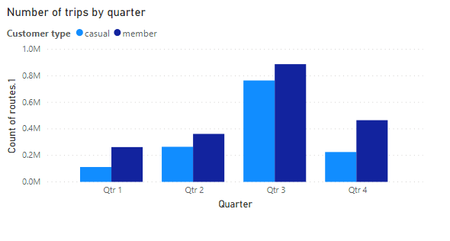
4. Findings
Number of trips raising high during the 3rd quarter
There are no difference between casual and annual in the seasonal element

Slide 12
5. Conclusions and recommendations
Casual customers differ from annual customers:
Trips duration / each trip
Riding weekday
Number of trips
Recommend to convert casual riders to annual customers
Fix price policy (who ride more, who pay more)
Run ads on social media in specified regions to approach casual customers
Show casual customers the benefits of membership like they can ride unlimited times

Slide 13
6. Further analysis
To answer 2 questions that I mentioned we need more data and analysis
Annual customers are more likely bike for commuting and casual bike for entertaining?
Casual customers pay for hour-by-hour bike ride, why annual customer gain more profit? And why they don’t use the membership?
To do that we need to conduct survey customers

Slide 14
Thank you

